Slide 1
OCN 479-001: Smart Coasts
Week 7
Power Budget, Sensor specs, Metadata vs datadata

Slide 2

Power Budgeting
How do you figure out how long something will last in the field?
How much capacity you have/how much sensor(s) will draw

Slide 3
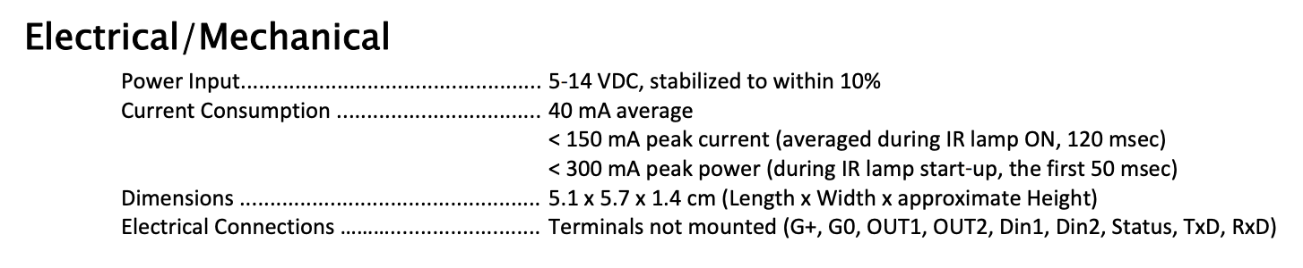
Power Budget for Sensor
Step 1: look up component datasheets, e.g.,

Slide 4
3.7 V “nominal”
Step 2: look up how much power you have, multiply A-h by V to get W-h
https://community.particle.io/t/can-argon-or-xenon-read-the-battery-state/45554/45?u=fragma
https://www.adafruit.com/product/258

Slide 5
Simple Estimate
We have 1200 mA*hr * 3.7 V = 4.44 W*hr
We will use > 40 mA * 5 V (for K-30; ignore microcontroller for now) = 200 mW = 0.2 W

Slide 6
Simple Estimate
We have 1200 mA*hr * 3.7 V = 4.44 W*hr
We will use > 40 mA * 5 V (for K-30; ignore microcontroller for now) = 200 mW = 0.2 W
So 4.44 W*hr/0.2 W = 22 hours

Slide 7
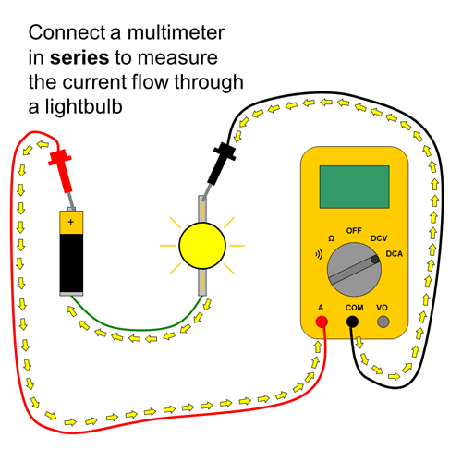
Taking it further: measure current in all states (e.g., sampling, sleeping, publishing)
https://www.sciencebuddies.org/science-fair-projects/references/how-to-use-a-multimeter

Slide 8
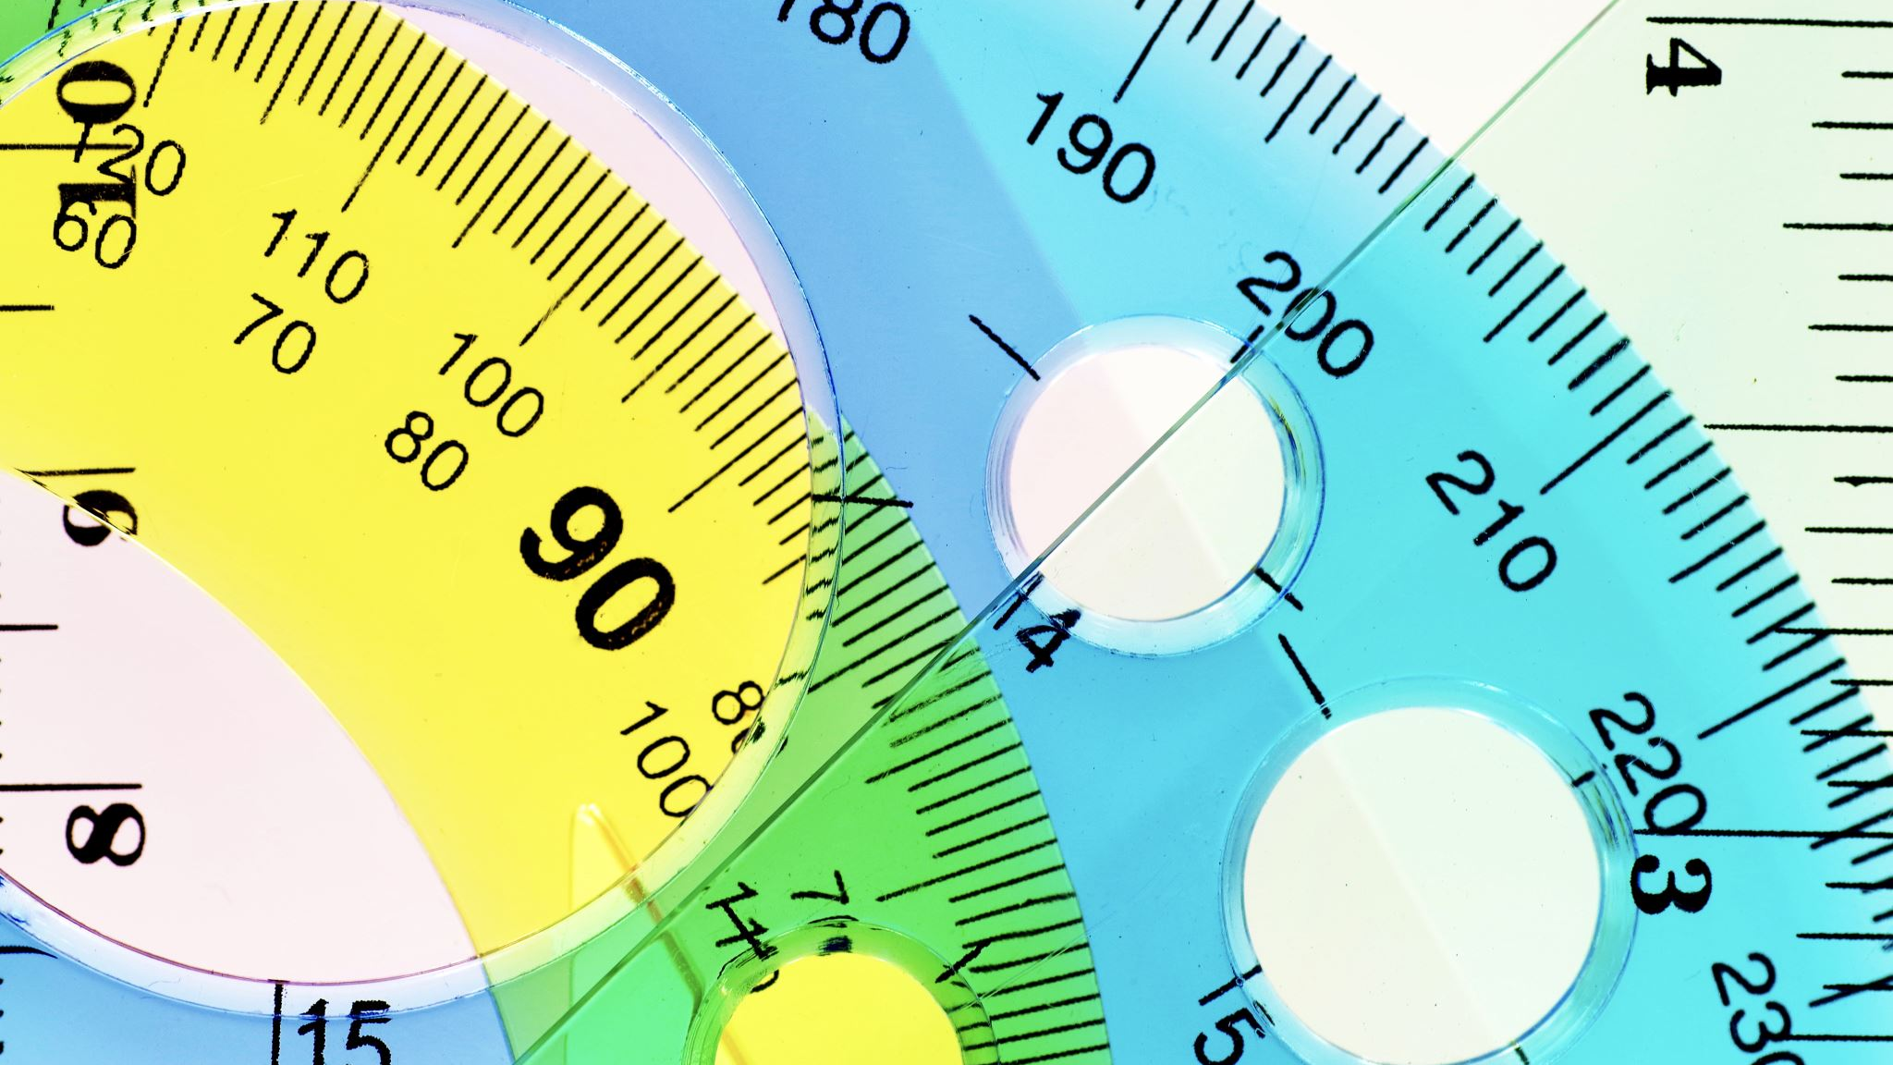
Sensor Specifications

Slide 9
Important Metrics
Match a letter from the left to the following:
Accurate but imprecise
Precise but inaccurate
Imprecise and inaccurate
Precise and accurate

Slide 10
Important Metrics
Match a letter from the left to the following:
Accurate but imprecise
Precise but inaccurate
Imprecise and inaccurate
Precise and accurate
C

Slide 11
Important Metrics
Match a letter from the left to the following:
Accurate but imprecise
Precise but inaccurate
Imprecise and inaccurate
Precise and accurate
C
B

Slide 12
Important Metrics
Match a letter from the left to the following:
Accurate but imprecise
Precise but inaccurate
Imprecise and inaccurate
Precise and accurate
C
B
A
D

Slide 13
Important Metrics
Example: ”true” temperature is 100 ºC
Take 10 samples. Get average and stdev (report as average±stdev)
Accurate but imprecise: thermometer measures 100.1±36 ºC
Inaccurate but precise: thermometer measures 56±0.2 ºC
Inaccurate, imprecise: 56±36 ºF
Accurate, precise: 100.1±0.2 ºC

Slide 14
Important Metrics
Extremely important: “accuracy” and “precision” are relative terms. Values ascribed to them depends on application!
Example: ”true” temperature is 100 ºF
Take 10 samples. Get average and stdev (report as average±stdev)
Accurate but imprecise: thermometer measures 100.1±36 ºC
Inaccurate but precise: thermometer measures 56±0.2 ºC
Inaccurate, imprecise: 56±36 ºF
Accurate, precise: 100.1±0.2 ºC

Slide 15
Important Metrics
Accuracy, precision
https://manoa.hawaii.edu/exploringourfluidearth/physical/world-ocean/map-distortion/practices-science-precision-vs-accuracy

Slide 16
Important Metrics
Accuracy, precision, stability
Continuing previous example:
Actual temperature not changing, but measurements are:
t = 0 min, T = 99.8±0.2 ºC
t = 10 min, T = 101.4±0.1 ºC
t = 20 min, T = 103.7±0.2 ºC
t = 0 min
t = 10 min
t = 20 min
https://manoa.hawaii.edu/exploringourfluidearth/physical/world-ocean/map-distortion/practices-science-precision-vs-accuracy

Slide 17
Important Metrics
Accuracy, precision, stability, resolution
Does your thermometer tell you temperature to 1 degree? 0.1? 0.01?
Just because there are more decimal points (higher resolution) does not mean it is more accurate!
https://www.allsensors.com/engineering-resources/white-papers/accuracy-and-precision-for-mems-pressure-sensors

Slide 18
Important Metrics
Accuracy/precision/stability/resolution
Response time (imagine you move a thermometer from an icewater bucket to a pot of boiling water; how long will it take for the thermometer to change temps?)
https://blog.wika.us/products/temperature-products/temperature-sensors-thermowells-and-response-times/

Slide 19
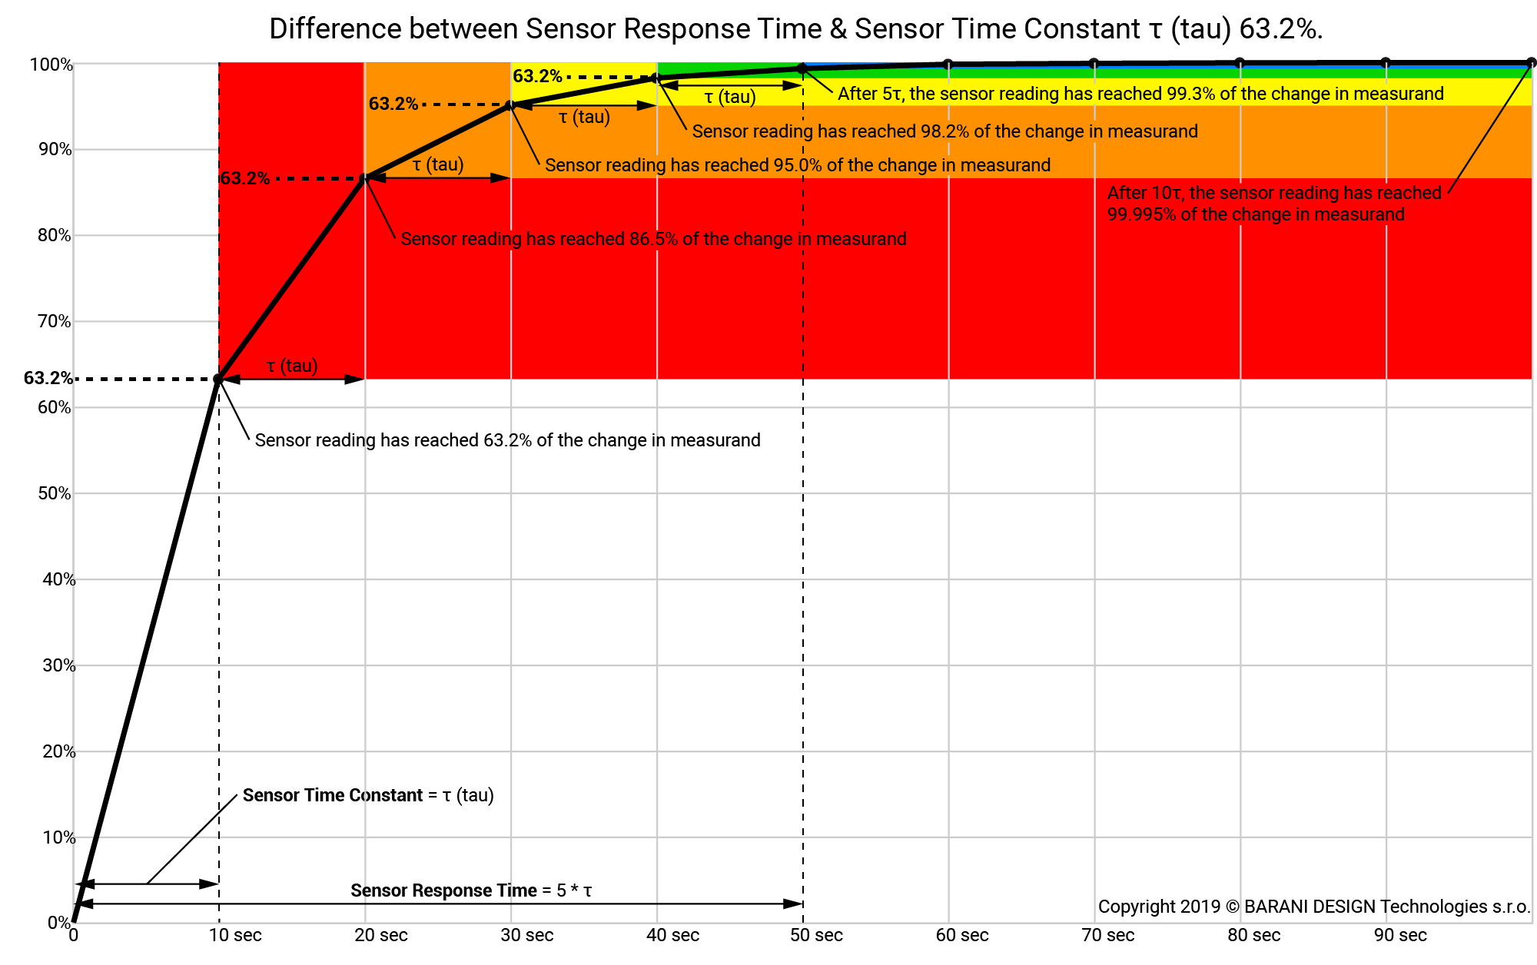
Response time defined
https://www.baranidesign.com/faq-articles/2019/5/6/difference-between-sensor-response-time-and-sensor-time-constant-tau

Slide 20
Available technologies
Which value do sensor manufacturers use? (Whatever they want—zero consistency in this arena)
If your project requires accuracy, precision, stability, response time, etc., VERIFY for yourself
Some manufacturers very honest, some report “best case scenario” or results of one specific, narrowly defined test

Slide 21
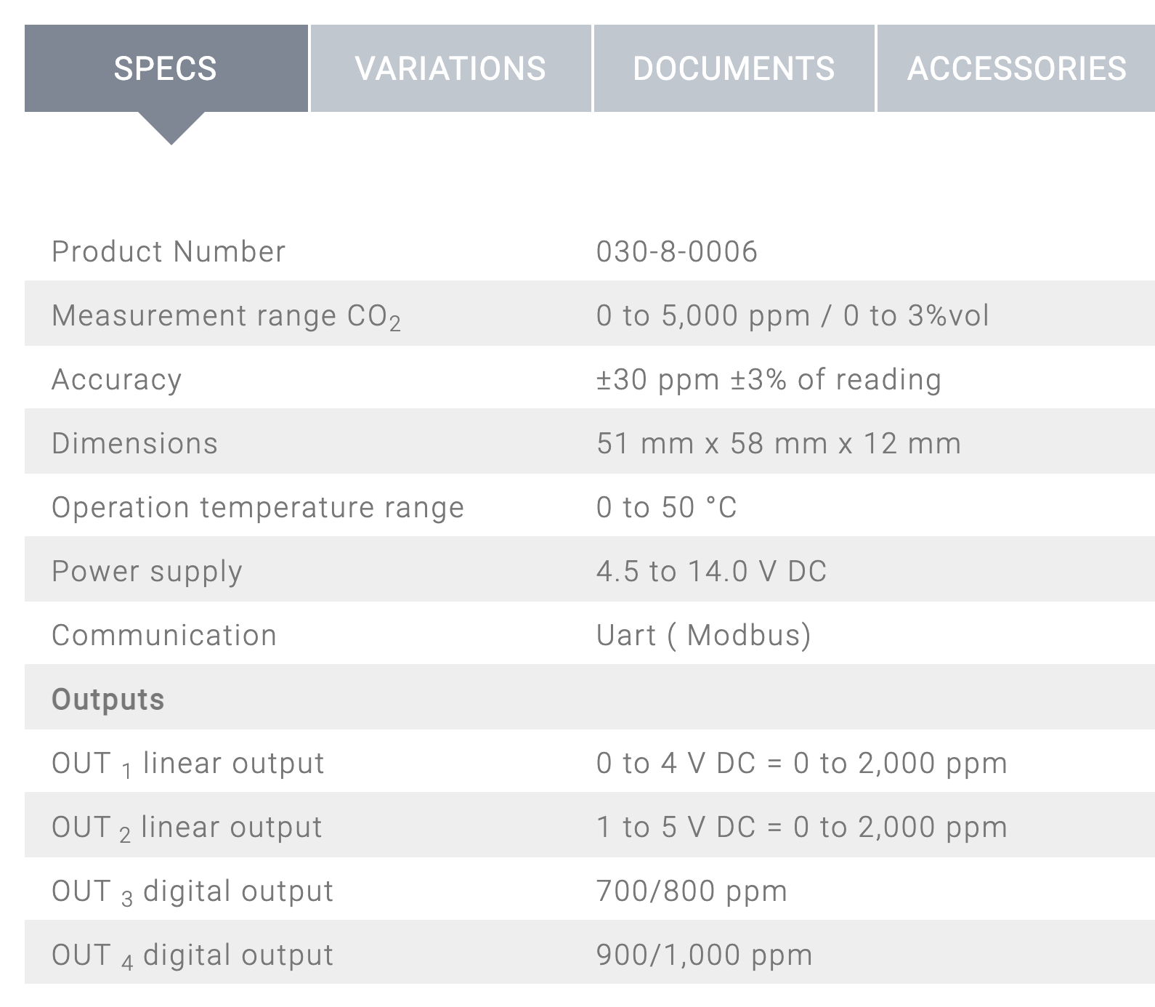
Spec sheet example
What is accuracy @ current atmospheric CO2?
Just because it works over a range of temp, pressure, salinity, etc. doesn’t mean it performs the same!

Slide 22
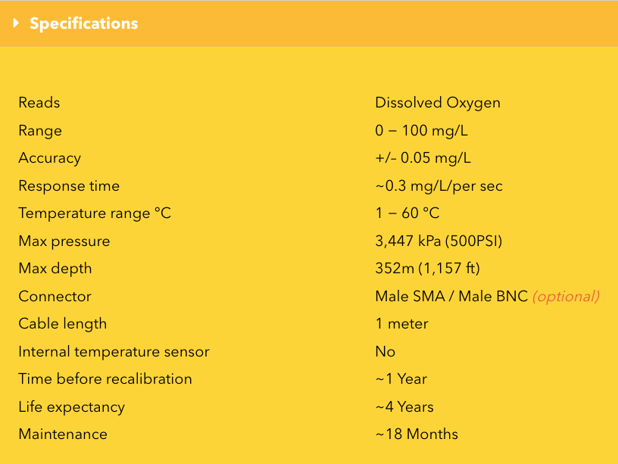
Spec sheet example

Slide 23
Data and Metadata

Slide 24
Data vs. Metadata
Data:
A measurement (from a sensor, analyzer, a ruler, etc.)
Observations, including numbers and words

Slide 25
Data vs. Metadata
Data:
A measurement (from a sensor, analyzer, a ruler, etc.)
Observations, including numbers and words
Metadata
Data about the data
How were data collected?
What was the instrument?
When was it last calibrated?
What are its calibration coefficients?
Who made the measurement?

Slide 26
Why?
Research is meant to be reproducible
By you
By anyone who reads your paper, lab notebook, etc.
You’ll remember very little of your past work after weeks/months/years

Slide 27
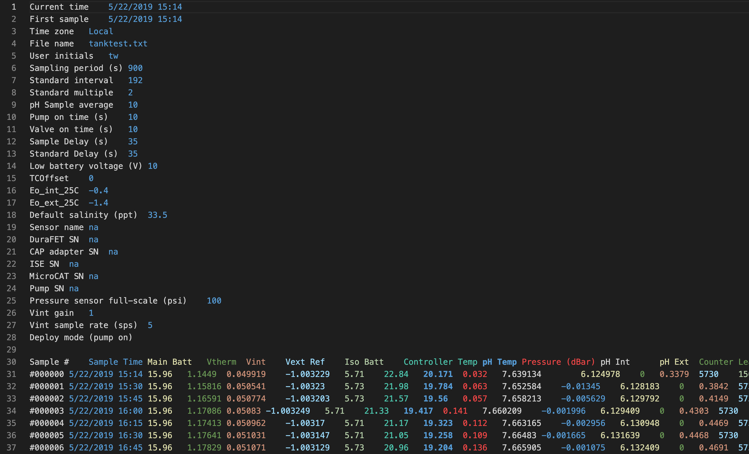

Slide 28
METADATA
COLUMN HEADERS
DATA

Slide 29
This week—>Fall Break—>
Consider what should be in your metadata and data. What info will you need?
Build sensors on breadboards and make measurements
Present (no slides needed) to class on Oct. 20 on wiring and code—how does your sensor do what it does? What is your plan for the second half of the semester?

